Slide 1
Problem Statement
- Wastage and management of electrical energy consumption

Slide 2
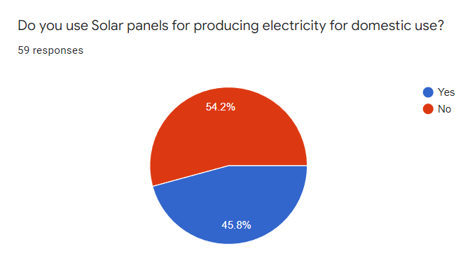
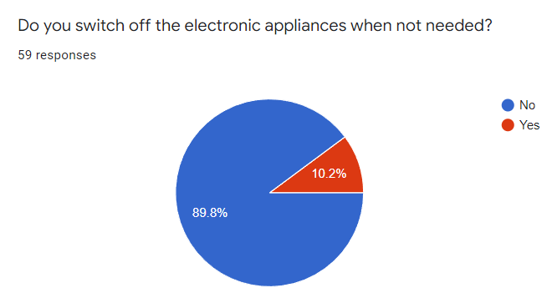
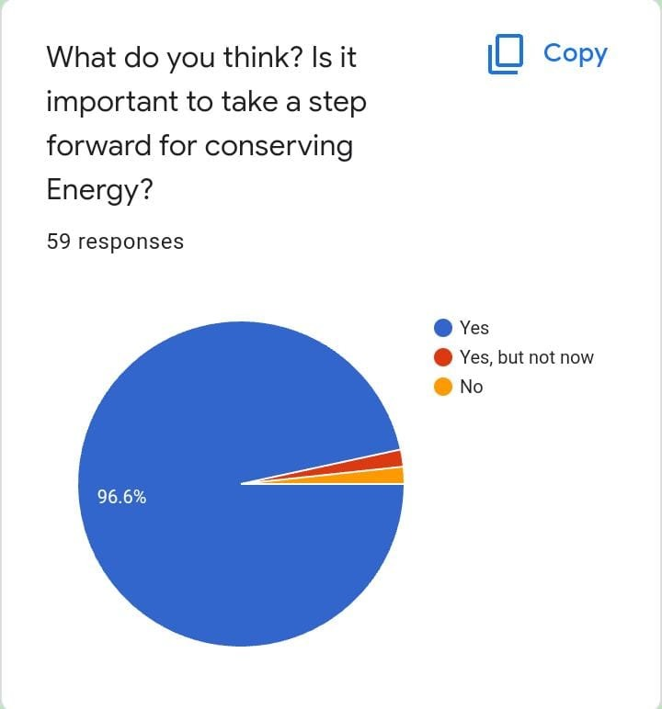
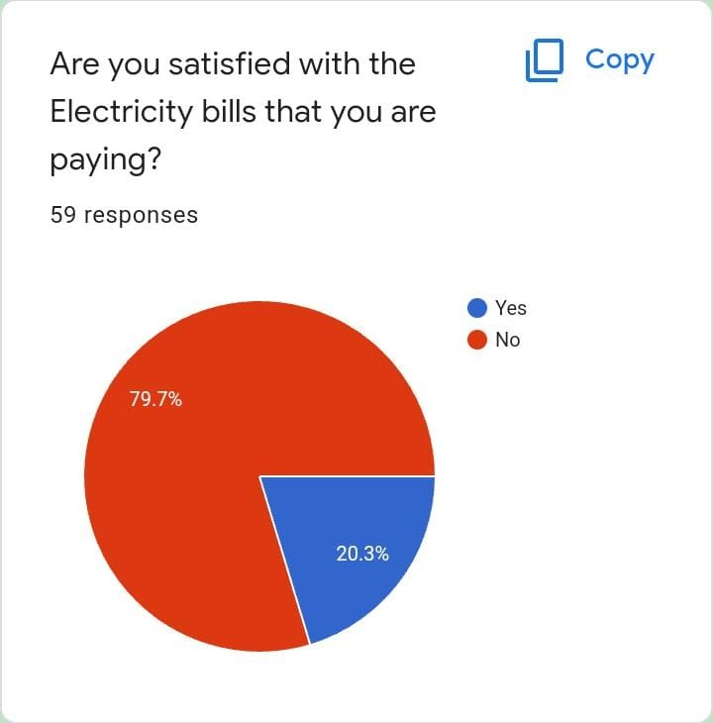
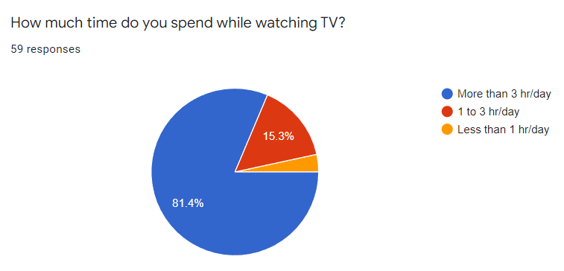
Analysis of responses of Survey

Slide 3
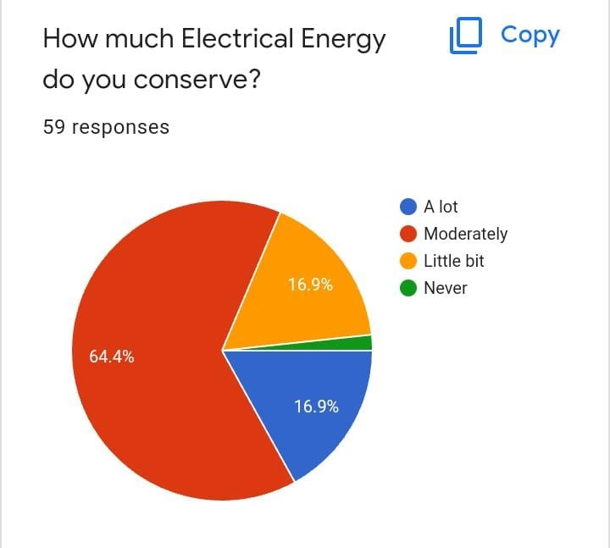
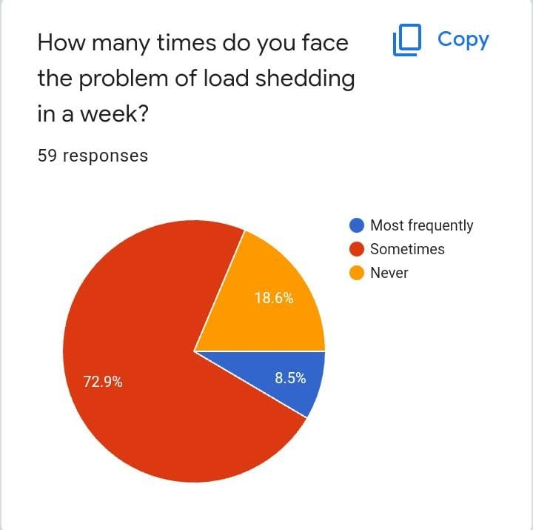
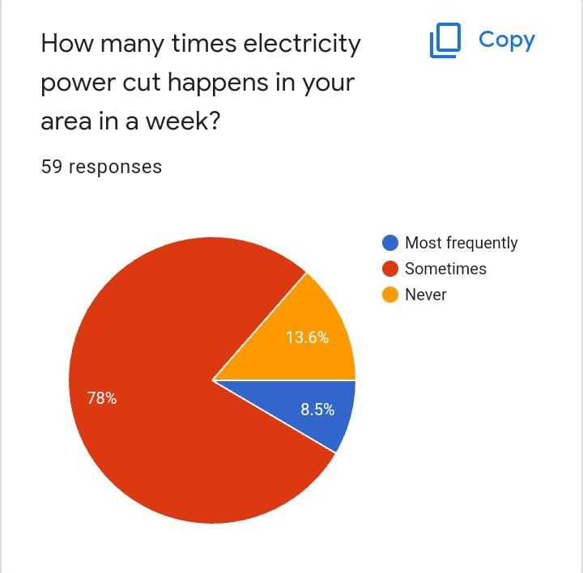

Slide 4
1) Smart Switch
Working principle:
- Detects the absence of Human ==> Accordingly turns Off the Appliances
- Works on the Principle of AI and uses Natural aggregation algorithm(NAA)

Slide 5
Hardware Used:-
1) Raspberry Pi 3
2) Webcam
3) LED
4) Monitor
Software Used:-
1) Python 3.7.3
- opencv-4.0.0
- opencv_cartrib
- numpy
2) Tensorflow lite
3) VS Code

Slide 6


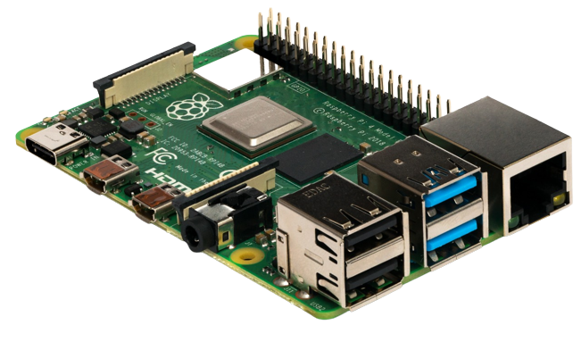

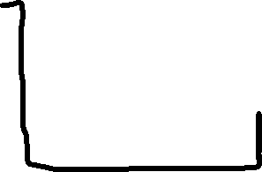


Python Code
Switch gets Off when no Human Detected
Human Detection after code execution
Camera as Input
Raspberry Pi

Slide 7
Good reasons for using a smart switch
1) Smart switch is often easier and more convenient to use.
2) Helps a lot in dark (absence of light) conditions .
3) programmable timing
4) Ambiance
5) Cost Saving

Slide 8
Smart Meters
Smart meter is basically a electric meter which not only gives the monthly consumption of electricity, but also gives the detail analysis .
Components include in Smart meters are : Power System, Micro controller and communications interface.

Slide 9
2) Smart Meter
- This smart meter will help us to analyze the energy consumption of every appliances/devices and will also generate real time power consumption of every devices. This Smart Meter uses Data Science for analyzing the data of electricity consumption of devices.
- This smart meter is computer application based, with the help computer, data analyzing will be easy.
- With the help this device we can get energy consumption statistics
Of every single devices and on the daily basis ,weekly basis , monthly basis and yearly basis . From which we can get a perfect idea of appliances consuming more energy and we can easily replace those with new advanced devices.

Slide 10
Advantages of Smart Meters
1) Will get accurate Bills
2) Can see usage of each devices
3) Can predict monthly and yearly bills
4) Efficiently manage the usage of devices

Slide 11
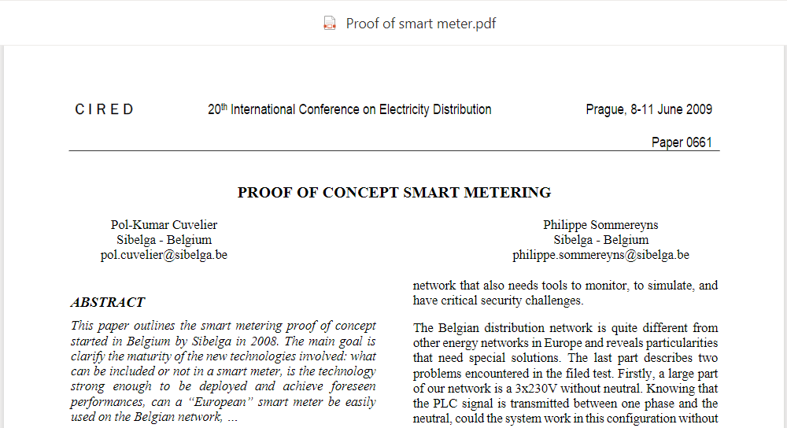
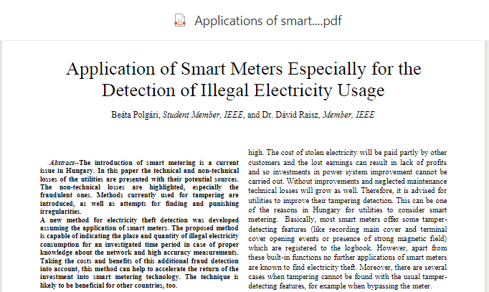
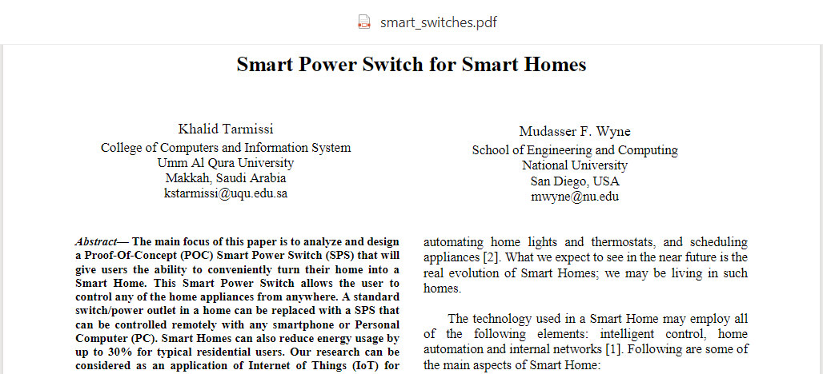
Proofs
‎
‎ ‎‎
‎

Slide 12
⚡THANK
YOU⚡

